Slide 1
High Qualification
Comission of Judges
of Ukraine
Key aspects
of the procedure for selecting candidates
for the position of a local court judge

Slide 2
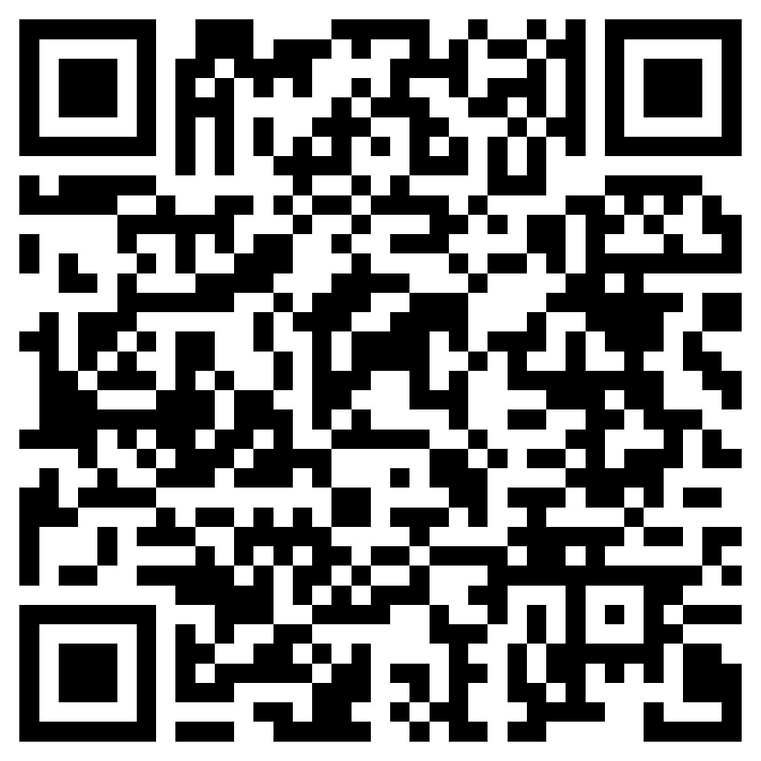
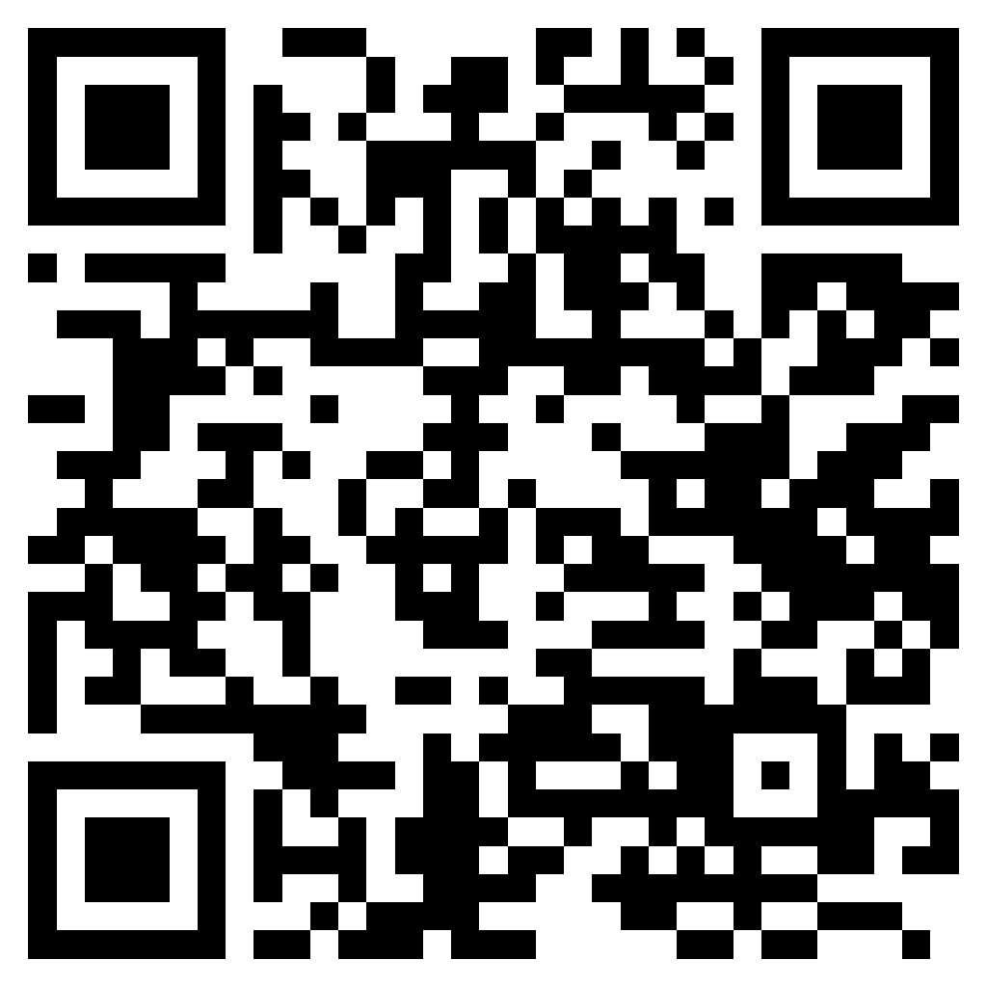
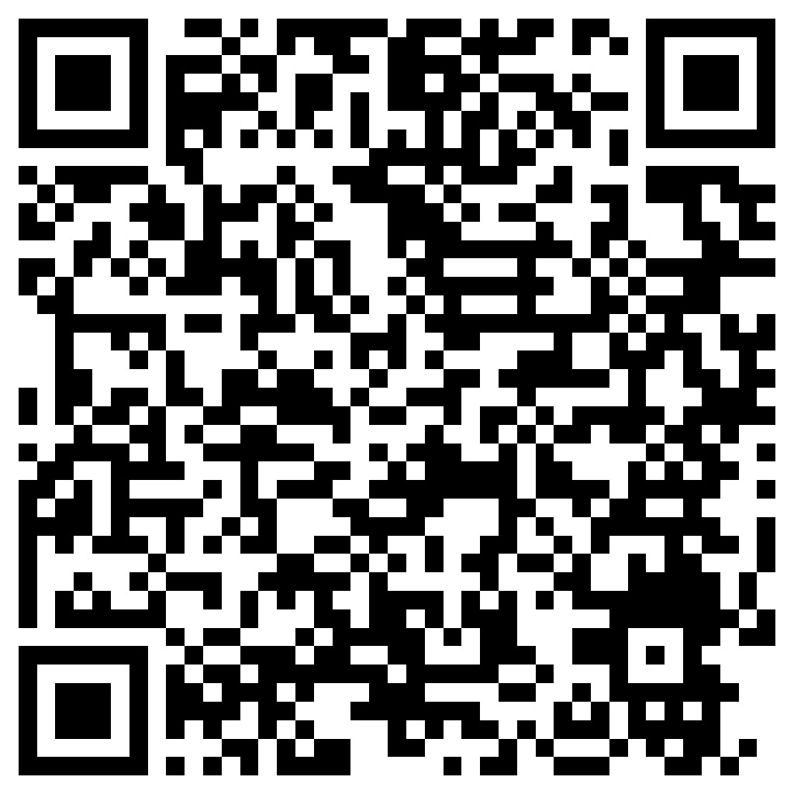
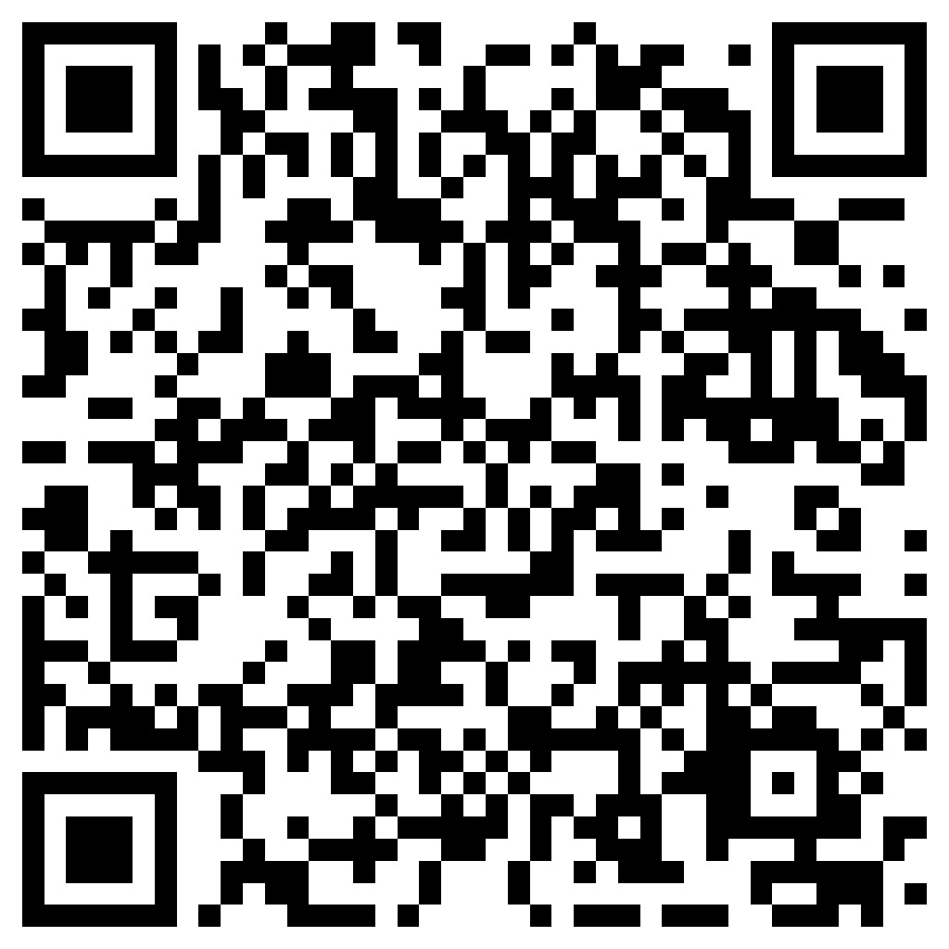
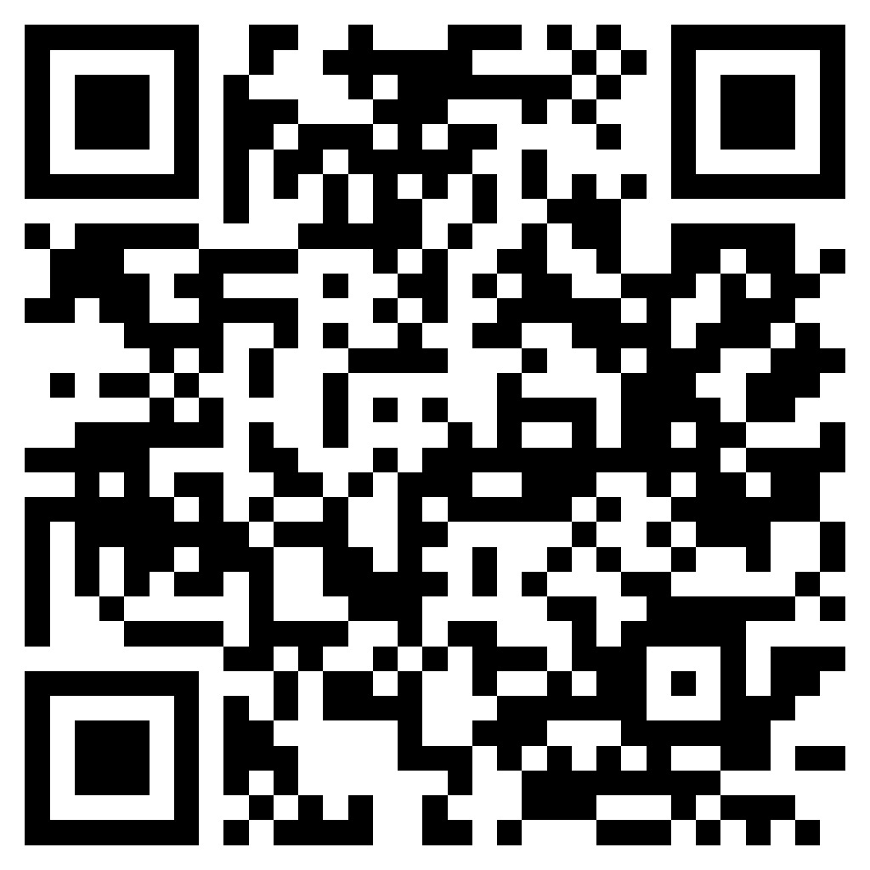
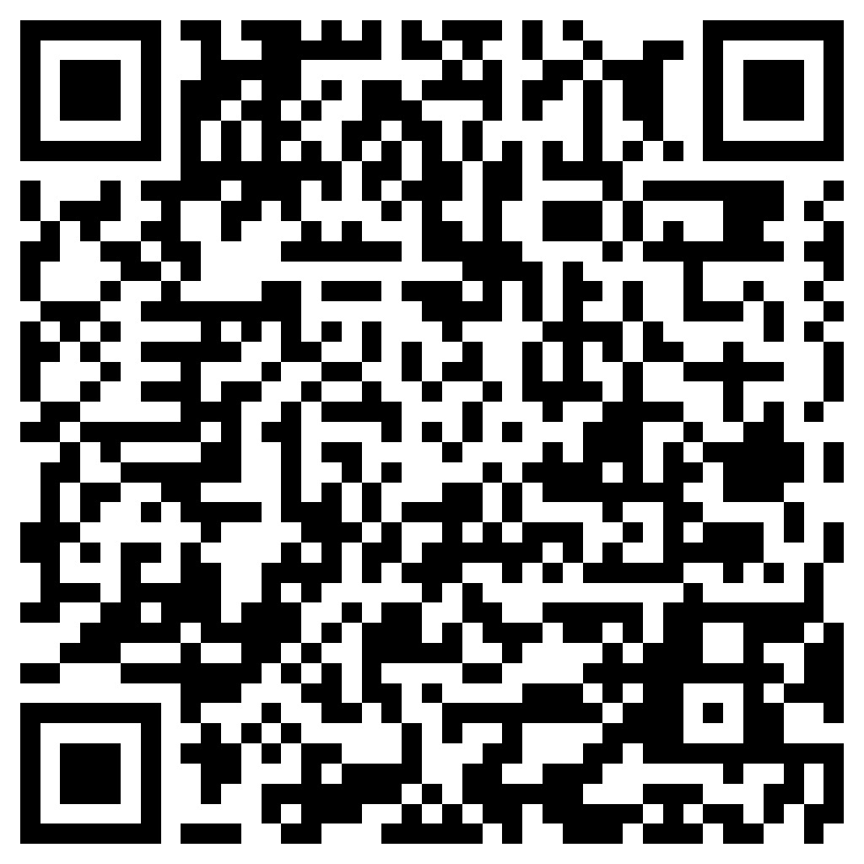
USEFUL LINKS
decision to announce the selection (in Ukrainian)
section
Useful information (in Ukrainian)
https://is.gd/yPUzXe
https://is.gd/uNfdv6
Judicial career cabinet (in Ukrainian)
announcement of the start of selection (in Ukrainian)
section
Questions and Answers (in Ukrainian)
https://ksk.vkksu.gov.ua
https://is.gd/JqN7o8
https://is.gd/zCUtdV
Google form for questions (in Ukrainian)
High Qualification
Comission of Judges
of Ukraine
https://is.gd/gX5eQf

Slide 3
High Qualification
Comission of Judges
of Ukraine
citizen of Ukraine
not younger than 30 and not older than 65 years old
REQUIREMENTS FOR THE CANDIDATE
higher legal education
at least 5 years of professional experience in the field of law
knowledge of the state language at the level of C1 or C2
suitability for the criteria of competence and integrity

Slide 4
High Qualification
Comission of Judges
of Ukraine
Submission of documents
Qualification exam
Announcement of the selection
Admission to the selection
EXPECTED TERMS
December
2024
March
2025
April-May
2025
June
2025
July
2025
August
2025
Testing of cognitive abilities
Testing of general knowledge in the field of law and court specialization
Testing on the history of Ukrainian statehood
Completion of practical assignments

Slide 5
High Qualification
Comission of Judges
of Ukraine
availability of a qualified electronic signature
оbtaining a certificate of proficiency in the state language
collecting documents to confirm five years of work experience
obtaining a medical certificate of health
TAKE CARE OF IT IN ADVANCE
carefully fill out the property declaration (on the NACP website) and the declaration of family ties and integrity (on the Commission's website)
correct operation of the browser with the Judicial Career Cabinet
suitability for the requirements on the DAY of application

Slide 6
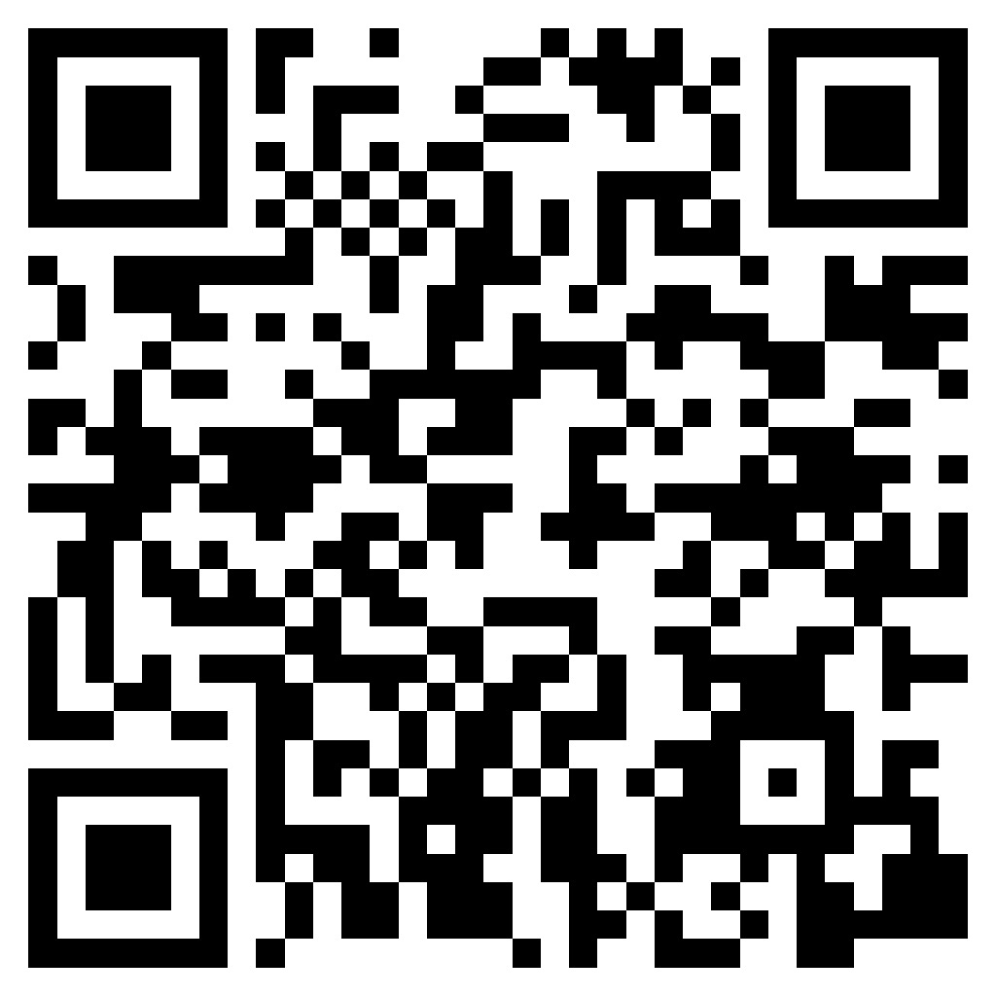
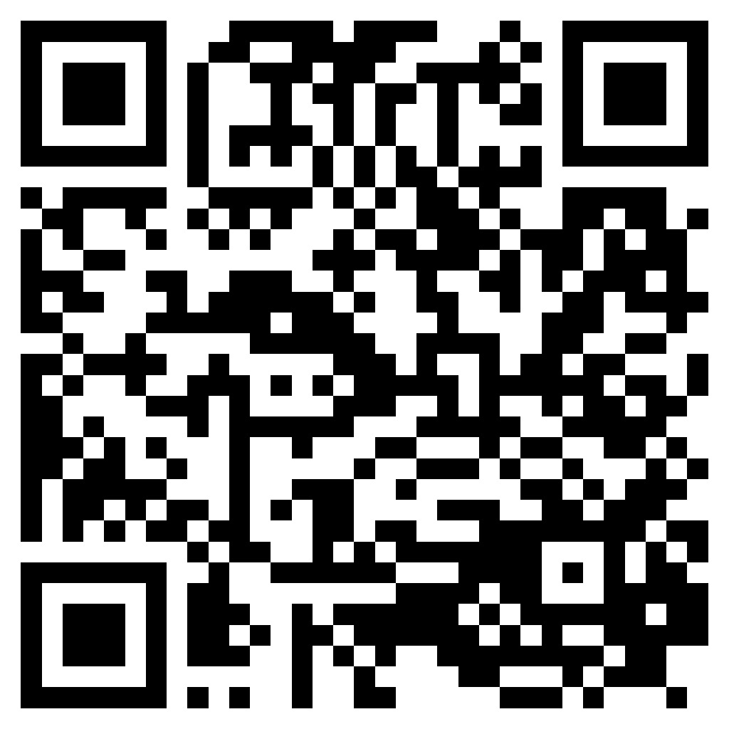
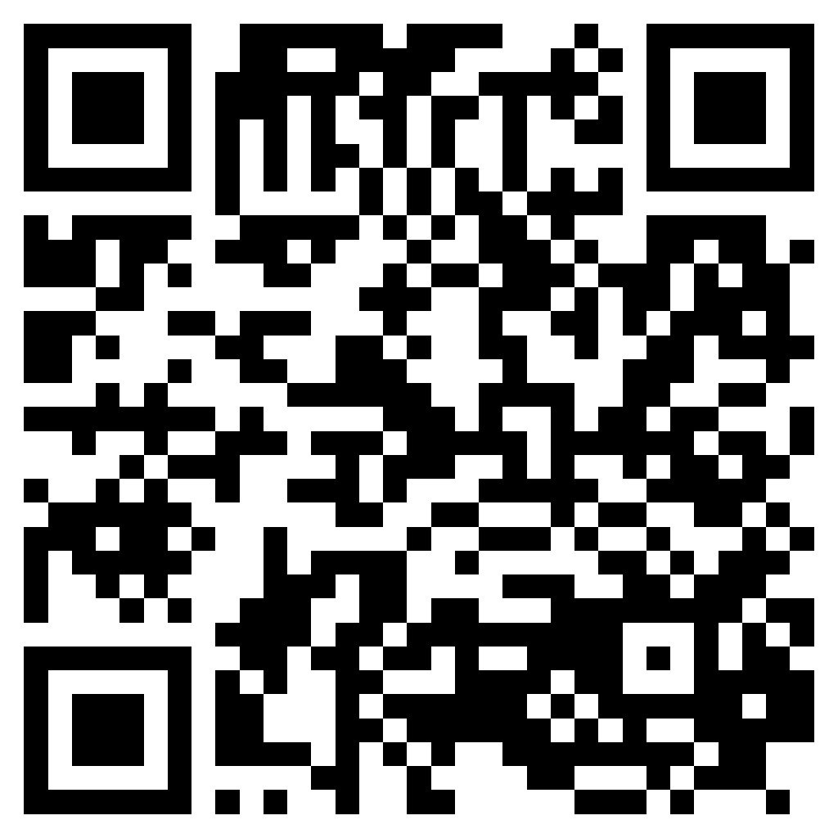
High Qualification
Comission of Judges
of Ukraine
for proper preparation
PUBLISHED
Background information on the content of anonymous cognitive testing (in Ukrainian)
https://is.gd/wx1cj7
Examination program and taxonomic characteristics of anonymous testing in the history of Ukrainian statehood + list of recommended reading (in Ukrainian)
QUALIFICATION
EXAM
https://is.gd/gCuB0K
Examination program and taxonomic characteristics of anonymous testing of general knowledge of law and each court specialization (in Ukrainian)
https://is.gd/W4IxYu

Slide 7
High Qualification
Comission of Judges
of Ukraine
30
the LIST OF QUESTIONS
for anonymous testing on the history of Ukrainian statehood, general knowledge of law and each court specialization
QUALIFICATION
EXAM
days before the exam
will be published

Slide 8
High Qualification
Comission of Judges
of Ukraine
10
the LIST OF CORRECT ANSWERS
to the questions of anonymous testing on the history of Ukrainian statehood, general knowledge of law and each court specialization
QUALIFICATION
EXAM
days before the exam
will be published

Slide 9
High Qualification
Comission of Judges
of Ukraine
THE PRACTICAL ASSIGNMENT
is carried out in relation to the specialization(s) chosen by the candidate:
administrative
QUALIFICATION
EXAM
commercial
general (civil and criminal)

Slide 10
High Qualification
Comission of Judges
of Ukraine
SPECIAL PROCEDURE FOR SUBMITTING DOCUMENTS
for military personnel directly involved in activities necessary to ensure the
defense of Ukraine
FOR THE FIRST TIME
from March 01
tо May 01, 2025 (inclusive)
submission of documents
“flexible” schedule of the qualification exam
qualification exam

Slide 11
High Qualification
Comission of Judges
of Ukraine
FOR THE FIRST TIME
QUALIFICATION EXAM
will be passed together with the candidate by judges who may later participate in the competition for the vacant position of a local court judge

Slide 12
High Qualification
Comission of Judges
of Ukraine
clarifications were published regarding
documents confirming the level of proficiency in the state language
USEFUL
INFORMATION
certain requirements for a candidate for the position of a local court judge
calculation of professional experience in the field of law
https://is.gd/uNfdv6 (in Ukrainian)

Slide 13
High Qualification
Comission of Judges
of Ukraine
answers to the following questions have been published
general selection issues
documents confirming the professional experience in the field of law
QUESTIONS AND ANSWERS
filling out the application form for a candidate for the position of a judge
declaration of assets
passing the qualification exam
section
Questions and answers
https://is.gd/zCUtdV (IN Ukrainian)

